Slide 1

Trust & Unity Emblem
Cultivating the conditions for trust and unity within our education systems and communities, to ensure that all learners are well served.

Slide 2
Trust & Unity Emblem with talking points
The people symbolize our learners being uplifted and served through our vision.
The stars symbolize the North Star guiding our Mission, Vision, Focus Areas, and Commitments.
The three circles with IU13 in the center symbolize how these elements work in unison to support the work of IU13.
The light bulb and puzzle pieces symbolize innovation, competency, and reliability.
The hands symbolize care, integrity, and collaboration.
Cultivating the conditions for trust and unity within our education systems and communities, to ensure that all learners are well served.

Slide 3

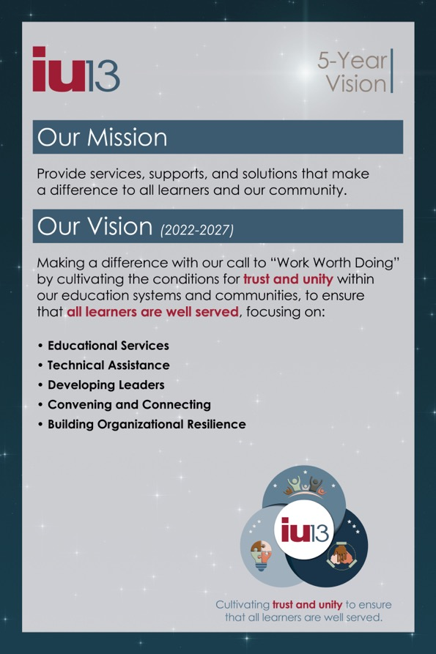
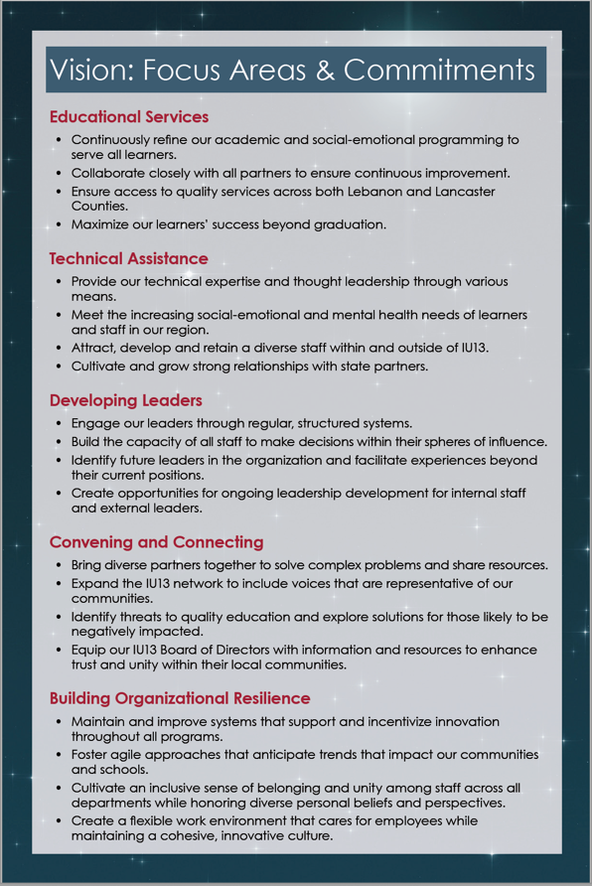
Dual posters at main locations, adjacent to large grid.
Combo poster at remote locations.

Slide 4

Center panel of grid will be tweaked, as shown.
OUR VISION:
Cultivating the conditions for trust and unity to ensure that all learners are well served.
KEYS TO OUR CULTURE:
Our vision relies on the
8 “Keys” to our innovative culture inspiring
Work Worth Doing.

Slide 5
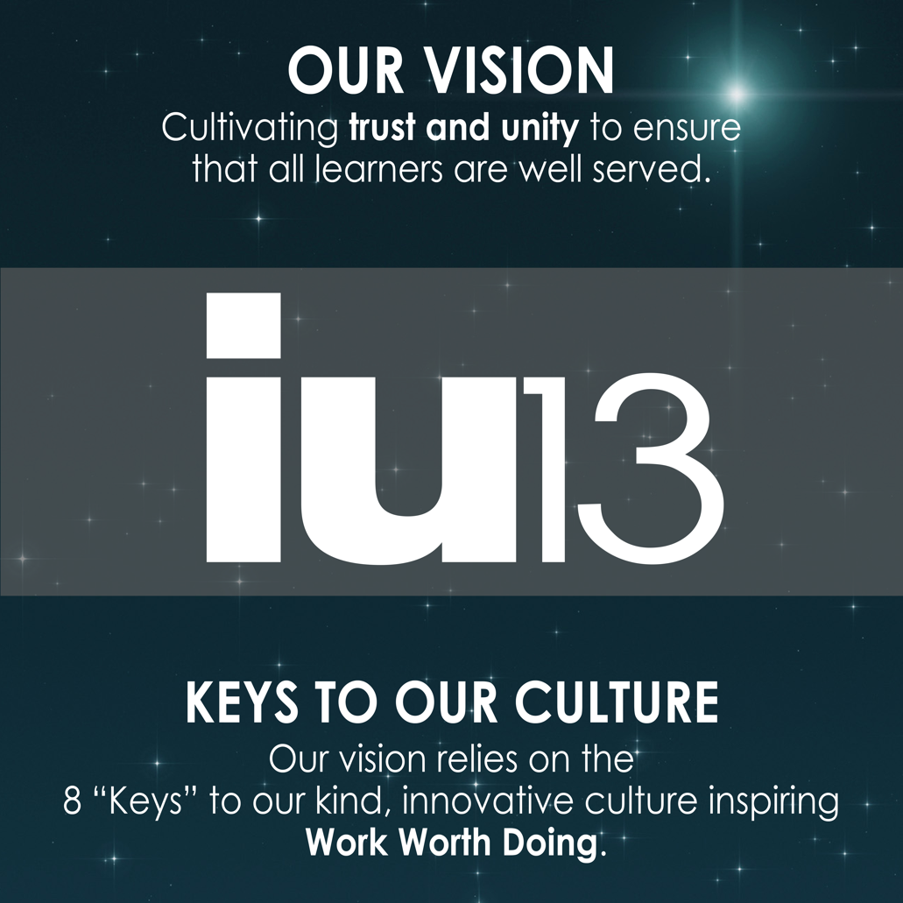
OUR VISION:
Cultivating the conditions for trust and unity to ensure that all learners are well served.
KEYS TO OUR CULTURE:
Our vision relies on the
8 “Keys” to our innovative culture inspiring
Work Worth Doing.

Slide 6

Best Efforts
We believe that our work requires us to be the best we can be. We value ingenuity, curiosity, and lifelong learning, and are intentional about providing opportunities for focused professional development and authentic work experiences.
We invest in building capacity and continuous improvement every day.

Slide 7

Responsible Stewardship
We believe that we have a responsibility to be good stewards of the funds and resources entrusted to our programs.
We make thoughtful decisions about resource allocation every day.

Slide 8

Relentless Pursuit of Excellence
We believe in being better tomorrow than we are today. We understand that “excellence is never an accident. It is always the result of high intention, sincere effort, and intelligent execution; it represents the wise choice of many alternatives – choice, not chance, determines your destiny.” – Aristotle
We strive to make intentional, well-informed, intelligent choices every day.

Slide 9

Kindness
We believe in one another and appreciate others for their efforts. We respect and accept our differences.
We say “Thank You” every chance we get.

Slide 10

Innovation
We see opportunities in every difficulty. We are innovation-friendly by providing our staff with opportunities to explore and play with new ideas and ways of doing things in an environment that is safe and supportive. We understand that cultivating intrapreneurship to solve tomorrow’s problems will ensure our future.
We acknowledge and reward innovation every chance we get.

Slide 11

Imperfection
We have a culture where mistakes are expected, respected, inspected, and corrected. We believe that mistakes are a necessary part of learning and successful innovation. We are not afraid to take ownership of our actions and are vulnerable in the exploration of solutions.
We fix the problem, not affix the blame, every chance we get.

Slide 12

Empathy
We believe in being supportive of and encouraging to those who might be struggling or need help. “[We’ve] learned that people will forget what you said, people will forget what you did, but people will never forget how you made them feel.” – M. Angelou
We offer a kind word and a helping hand every chance we get.

Slide 13

Collaboration
We believe two heads are better than one and that our best work occurs when we can tap into the diverse skills and talents of our team members.
We collaborate every chance we get.

